Slide 1
Implementation of Strassen’s Matrix Algorithm
Presented By:
Divyesh Rana - IIT2019063
Akash Deep - IIT2019064
Pedada Gopal - IIT2019065

Slide 2
Problem statement:
Implement strassen’s multiplication algorithm using divide and conquer technique

Slide 3
Explanation
What is matrix multiplication?
Matrix multiplication is a binary operation in which the first matrix has the equal number of columns as the number of rows in second matrix.
What is strassen’s multiplication algorithm?
It is an algorithm in which we use divide and conquer approach to decrease the number of multiplications in which in turn decreases the number of recursive calls to considerably reduce the time complexity for large inputs.

Slide 4


Algorithmic Design
Divide and Conquer
Divide both input matrices(A_{nxn},B_{nxn}) in four submatrices of size (n/2)x(n/2)
Use recursion to calculate values of,
(A₁₁B₁₁ + A₁₂B₂₁) ,(A₁₁B₁₂ + A₁₂B₂₂) , (A₂₁B₁₁ + A₂₂B₂₁) and (A₂₁B₁₂ + A₂₂B₂₂).

Slide 5
Cont.
Strassen’s Algorithm
Strassen’s Matrix Algorithm is an improvement in divide and conquer algorithm, In divide and conquer algorithm, there are 8 multiplication and so 8 recursive calls, but strassen devised a method to compute multiplication in 7 recursive calls which becomes much faster when matrices are of higher dimensions.

Slide 6


Strassen’s formula
P1 = A₁₁ × (B₁₂ − B₂₂)
P2 = (A₁₁ + A₁₂) × B₂₂
P3 = (A₂₁ + A₂₂) × B₁₁
P4 = A₂₂ × (B₂₁ − B₁₁)
P5 = (A₁₁ + A₂₂) × (B₁₁ + B₂₂)
P6 = (A₁₂ − A₂₂) × (B₂₁ + B₂₂)
P7 = (A₁₁ − A₂₁) × (B₁₁ + B₁₂)
C₁₁ = P5 + P4 - P2 + P6
C₁₂ = P1 + P2
C₂₁ = P3 + P4
C₂₂ = P5 + P1 − P3 − P7
Total no. of multiplications = 7 and with some additions and subtractions, So we will get the recurrence relation for time complexity:

Slide 7
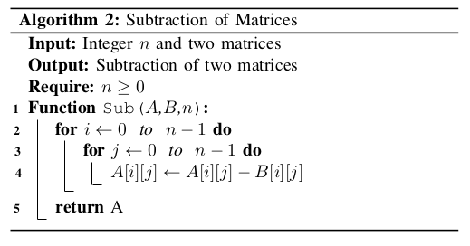
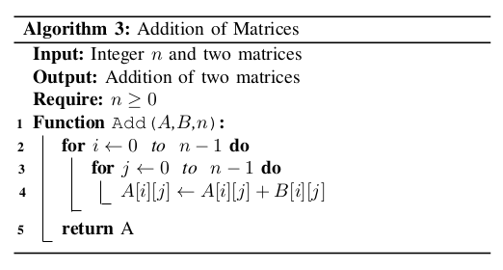
Subtraction and addition of matrices
We will run a loop with index i for elements of each row and run a loop with index j for elements of each column and compute addition and subtraction indices wise, i.e C[i][j] = A[i][j] + B[i][j] and C = A + B similarly for subtraction.

Slide 8
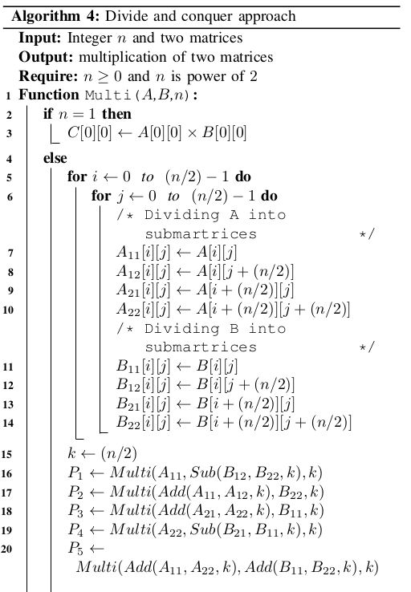
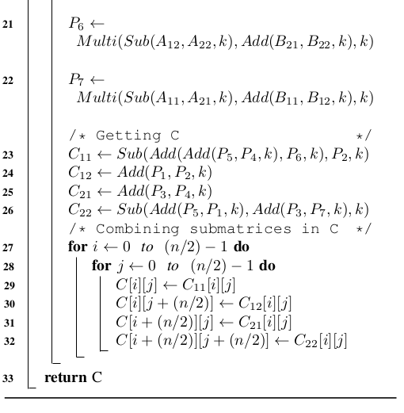
Strassen’s Algorithm using Divide and Conquer

Slide 9
Algorithm analysis
Time Complexity:
Divide and conquer approach has recurrence relation T(n) = 8T(n/2) + O(n²), because we do 8 multiplication (two for computing each submatrix of C) and some Additions. So this algorithm has O(n³) complexity.
Strassen’s algorithm reduces the number of multiplication and so reduces the complexity: It has recurrence relation T(n) = 7T(n/2) + O(n²). So this algorithm has O(n^{log7}) = O(n^{2.8})
Space complexity:
The space complexity for the algorithm is O(n²)

Slide 10
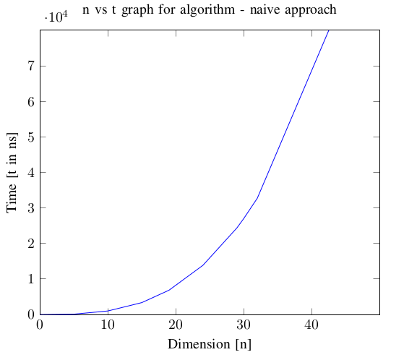
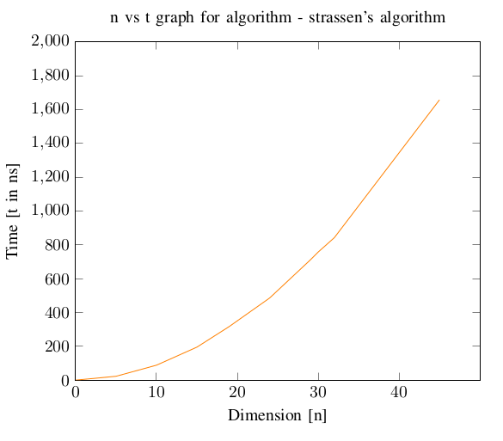
Experimental Analysis
n³ Behaviour
Something like sub-cubic(n^{2.8}) Behaviour

Slide 11
Conclusion
considering the time complexity and for large inputs,From the naive approach of O(n³) to the strassen’s multiplication algorithm where it was decreased to O(n^{2.8}).

